Slide 1
Data Structures and Algorithms I
Data Structures and Algorithms I
Lecture 2– Algorithm Analysis
Miao Zhang

Slide 2

What is an algorithm

Slide 3
Introduction
What is Algorithm?
  a clearly specified set of simple instructions to be followed to solve a problem
    Takes a set of values, as input and
    produces a value, or set of values, as output
  May be specified
    In English
    As a computer program
    As a pseudo-code
Data structures
  Methods of organizing data
Program = algorithms + data structures

Slide 4
Introduction
Why need algorithm analysis ?
  writing a working program is not good enough
  The program may be inefficient!
  If the program is run on a large data set, then the running time becomes an issue

Slide 5
Example: Selection Problem
Given a list of N numbers, determine the kth largest, where k ≤ N.
Algorithm 1:
  (1) Read N numbers into an array
  (2) Sort the array in decreasing order by some simple algorithm
  (3) Return the element in position k

Slide 6
Example: Selection Problem…
Algorithm 2:
  (1) Read the first k elements into an array and sort them in decreasing order
  (2) Each remaining element is read one by one
    If smaller than the kth element, then it is ignored
    Otherwise, it is placed in its correct spot in the array, bumping one element out of the array.
  (3) The element in the kth position is returned as the answer.

Slide 7
Example: Selection Problem…
Which algorithm is better when
  N =100 and k = 100?
  N =100 and k = 1?
What happens when N = 1,000,000 and k = 500,000?
There exist better algorithms

Slide 8





Overall Picture
Data Structure and Algorithm Design Goals
Implementation Goals
Correctness
Robustness
Adaptability
Efficiency
Reusability

Slide 9
Algorithm Analysis
We only analyze correct algorithms
An algorithm is correct
  If, for every input instance, it halts with the correct output
Incorrect algorithms
  Might not halt at all on some input instances
  Might halt with other than the desired answer
An algorithm must be correct. It should correctly solve the problem.
  e.g. For sorting, this means even if (1) the input is already sorted, or (2) it contains repeated elements
Analyzing an algorithm
  Predicting the resources that the algorithm requires
  Resources include
    Memory
    Communication bandwidth
    Computational time (usually most important)

Slide 10
Algorithm Analysis…
Once we have a correct algorithm for a problem, we have to determine the efficiency of that algorithm.
Factors affecting the running time
  computer
  compiler
  algorithm used
  input to the algorithm
    The content of the input affects the running time
    typically, the input size (number of items in the input) is the main consideration
      E.g. sorting problem ⇒ the number of items to be sorted
      E.g. multiply two matrices together ⇒ the total number of elements in the two matrices
Machine model assumed
  Instructions are executed one after another, with no concurrent operations

Slide 11
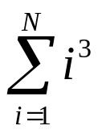
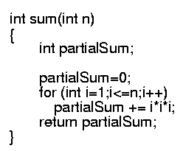
Example
Calculate
Lines 1 and 4 count for one unit each
Line 3: executed N times, each time four units
Line 2: (1 for initialization, N+1 for all the tests, N for all the increments) total 2N + 2
total cost: 6N + 4 ⇒ O(N)
1
2
3
4
1
2N+2
4N
1

Slide 12
Algorithmic Performance
There are two aspects of algorithmic performance:
Time
    Instructions take time.
    How fast does the algorithm perform?
    What affects its runtime?
Space
    Data structures take space
    What kind of data structures can be used?
    How does choice of data structure affect the runtime?
We will focus on time:
  How to estimate the time required for an algorithm
  How to reduce the time require

Slide 13
Algorithm Analysis
Efficiency of an algorithm can be analyzed at two different stages, before implementation and after implementation, as mentioned below
A priori analysis − This is theoretical analysis of an algorithm. Efficiency of an algorithm is measured by assuming that all other factors e.g. processor speed, are constant and have no effect on implementation.
A posterior analysis − This is empirical analysis of an algorithm. The selected algorithm is implemented using a programming language. This is then executed on a target computer machine. In this analysis, actual statistics like running time and space required, are collected.

Slide 14
Asymptotic Analysis
Asymptotic analysis refers to computing the running time of any operation in mathematical units of computation.
  For example, running time of one operation is computed as f(n) and may be for another operation it is computed as g(n²). Which means first operation running time will increase linearly with the increase in n， and running time of second operation will increase exponentially when n increases. Similarly the running time of both operations will be nearly same if n is significantly small.

Slide 15
Asymptotic Analysis
Asymptotic analysis of an algorithm, refers to defining the mathematical boundation/framing of its run-time performance.
Using asymptotic analysis, we can very well conclude the best case, average case and worst case scenario of an algorithm.
Asymptotic analysis are input bound i.e., if there's no input to the algorithm it is concluded to work in a constant time. Other than the "input" all other factors are considered constant.

Slide 16
Worst- / average- / best-case
Worst-case running time of an algorithm
  The longest running time for any input of size n
  An upper bound on the running time for any input
  ⇒ guarantee that the algorithm will never take longer
  Example: Sort a set of numbers in increasing order; and the data is in decreasing order
  The worst case can occur fairly often
    E.g. in searching a database for a particular piece of information
Best-case running time
  sort a set of numbers in increasing order; and the data is already in increasing order
Average-case running time
  May be difficult to define what “average” means

Slide 17
Running-time of algorithms
Bounds are for the algorithms, rather than programs
  programs are just implementations of an algorithm, and almost always the details of the program do not affect the bounds
Bounds are for algorithms, rather than problems
  A problem can be solved with several algorithms, some are more efficient than others

Slide 18
Asymptotic Analysis
To compare two algorithms with running times f(n) and g(n), we need a rough measure that characterizes how fast each function grows.
Hint: use rate of growth
Compare functions in the limit, that is, asymptotically!
  (i.e., for large values of n)

Slide 19
Algorithm Growth Rates
We measure an algorithm’s time is n
  Algorithm A requires 5*n² time units to solve a problem of size n.
  Algorithm B requires 7*n time units to solve a problem of size n.
The most important thing to learn is how quickly the algorithm’s time requirement grows as a function of the problem size.
  Algorithm A requires time proportional to n².
  Algorithm B requires time proportional to n.
An algorithm’s proportional time requirement is known as growth rate.
We can compare the efficiency of two algorithms by comparing their growth rates.

Slide 20
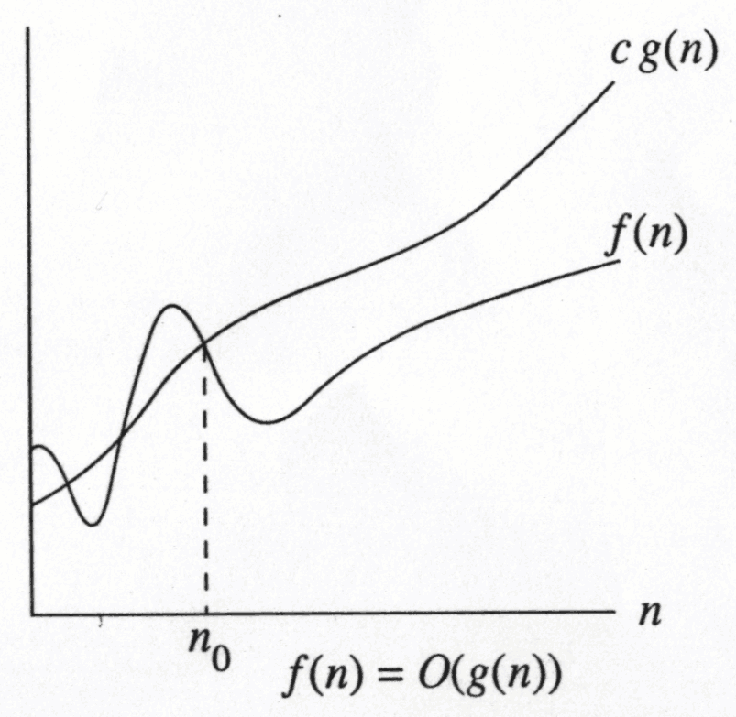
Growth Rate
The idea is to establish a relative order among functions for large n
∃ c , n₀ > 0 such that f(n) ≤ c g(n) when N ≥ n₀
f(n) grows no faster than g(n) for “large” N

Slide 21
Asymptotic notation: Big-Oh
f(N) = O(g(N))
There are positive constants c and n₀ such that
f(N) ≤ c g(N) when N ≥ n₀
The growth rate of f(N) is less than or equal to the growth rate of g(N)
g(N) is an upper bound on f(N)

Slide 22
Big-Oh: example
Let f(N) = 2N². Then
  f(N) = O(N⁴)
  f(N) = O(N³)
  f(N) = O(N²) (best answer, asymptotically tight)
O(N²): reads “order N-squared” or “Big-Oh N-squared”

Slide 23
Some rules
When considering the growth rate of a function using Big-Oh
Ignore the lower order terms and the coefficients of the highest-order term
No need to specify the base of logarithm
  Changing the base from one constant to another changes the value of the logarithm by only a constant factor
If T₁(N) = O(f(N) and T₂(N) = O(g(N)), then
  T₁(N) + T₂(N) = max(O(f(N)), O(g(N))),
  T₁(N) * T₂(N) = O(f(N) * g(N))

Slide 24
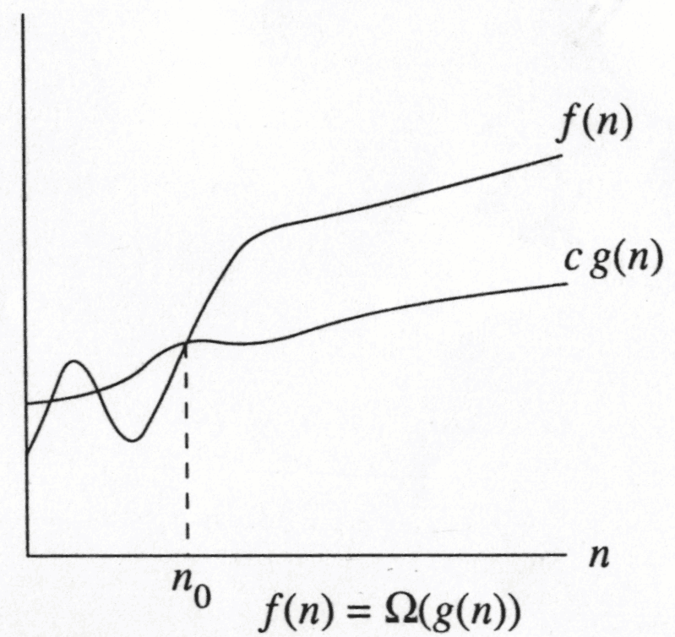
Big-Omega
∃ c , n₀ > 0 such that f(N) ≥ c g(N) when N ≥ n₀
f(N) grows no slower than g(N) for “large” N

Slide 25
Big-Omega
f(N) = Ω(g(N))
There are positive constants c and n₀ such that
f(N) ≥ c g(N) when N ≥ n₀
The growth rate of f(N) is greater than or equal to the growth rate of g(N).

Slide 26
Big-Omega: examples
Let f(N) = 2N². Then
  f(N) = Ω(N)
  f(N) = Ω(N²) (best answer)

Slide 27
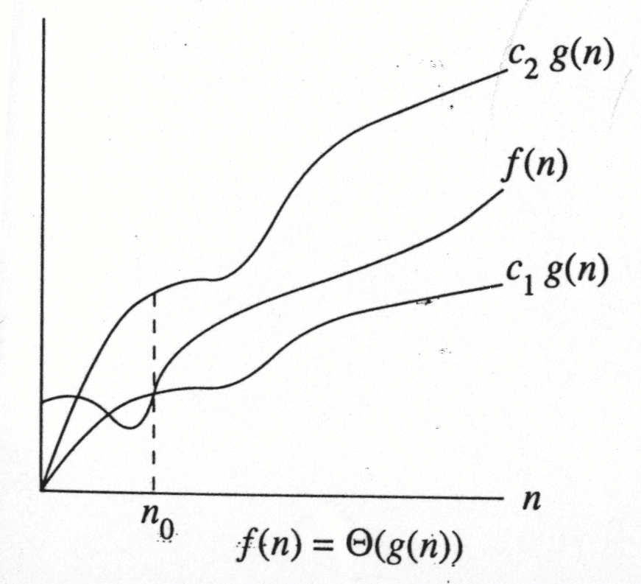
f(N) = Θ(g(N))
the growth rate of f(N) is the same as the growth rate of g(N)

Slide 28
Big-Theta
f(N) = Θ(g(N)) iff
f(N) = O(g(N)) and f(N) = Ω(g(N))
The growth rate of f(N) equals the growth rate of g(N)
Example: Let f(N)=N² , g(N)=2N²
  Since f(N) = O(g(N)) and f(N) = Ω(g(N)),
  thus f(N) = Θ(g(N)).
Big-Theta means the bound is the tightest possible.

Slide 29
Some rules
If T(N) is a polynomial of degree k, then
T(N) = Θ(N^{k}).
For logarithmic functions,
  T(log_{m} N) = Θ(log N).

Slide 30
Common Growth Rates
Function | Growth Rate Name
c | Constant
log N | Logarithmic
log²N | Log-squared
N | Linear
N log N
N² | Quadratic
N³ | Cubic
2^{N} | Exponential

Slide 31
Growth rates …
Doubling the input size
  f(N) = c ⇒ f(2N) = f(N) = c
  f(N) = log N ⇒ f(2N) = f(N) + log 2
  f(N) = N ⇒ f(2N) = 2 f(N)
  f(N) = N² ⇒ f(2N) = 4 f(N)
  f(N) = N³ ⇒ f(2N) = 8 f(N)
  f(N) = 2^{N} ⇒ f(2N) = f²(N)
Advantages of algorithm analysis
  To eliminate bad algorithms early
  pinpoints the bottlenecks, which are worth coding carefully

Slide 32

General Rules
For loops
  at most the running time of the statements inside the for-loop (including tests) times the number of iterations.
Nested for loops
  the running time of the statement multiplied by the product of the sizes of all the for-loops.
  O(N²)

Slide 33
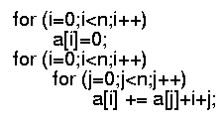
General rules (cont’d)
Consecutive statements
  These just add
  O(N) + O(N²) = O(N²)
If Sa1
Else S2
  never more than the running time of the test plus the larger of the running times of S1 and S2.
Divide-and-conquer
Divide-and-conquer

Slide 34
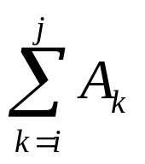
Another Example
Maximum Subsequence Sum Problem
Given (possibly negative) integers A₁, A₂, ...., A_{n}, find the maximum value of
  For convenience, the maximum subsequence sum is 0 if all the integers are negative
E.g. for input –2, 11, -4, 13, -5, -2
  Answer: 20 (A₂ through A₄)

Slide 35
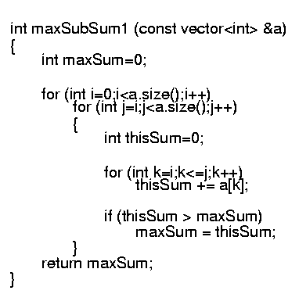
Algorithm 1: Simple
Exhaustively tries all possibilities (brute force)
O(n³)

Slide 36
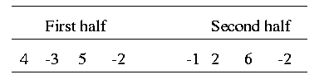
Algorithm 2: Divide-and-conquer
Divide-and-conquer
  split the problem into two roughly equal subproblems, which are then solved recursively
  patch together the two solutions of the subproblems to arrive at a solution for the whole problem
The maximum subsequence sum can be
  Entirely in the left half of the input
  Entirely in the right half of the input
  It crosses the middle and is in both halves

Slide 37
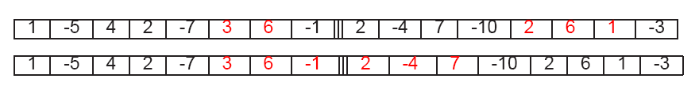
Algorithm 2 (cont’d)
The first two cases can be solved recursively
For the last case:
  find the largest sum in the first half that includes the last element in the first half
  the largest sum in the second half that includes the first element in the second half
  add these two sums together

Slide 38
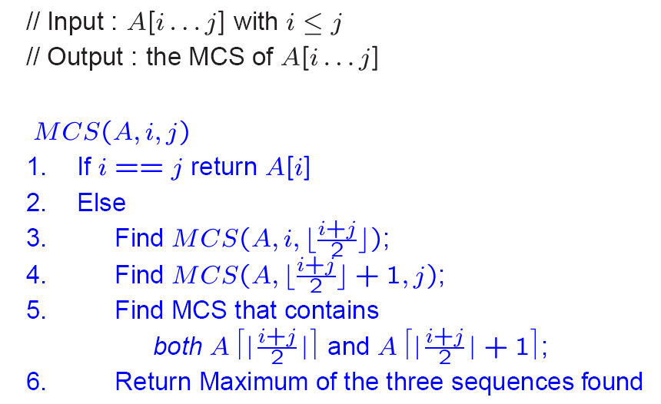
Algorithm 2 …
O(1)
T(m/2)
T(m/2)
O(m)
O(1)

Slide 39
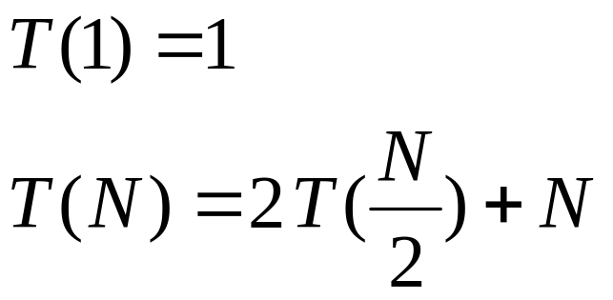
Algorithm 2 (cont’d)
Recurrence equation
  2 T(N/2): two subproblems, each of size N/2
  N: for “patching” two solutions to find solution to whole problem

Slide 40
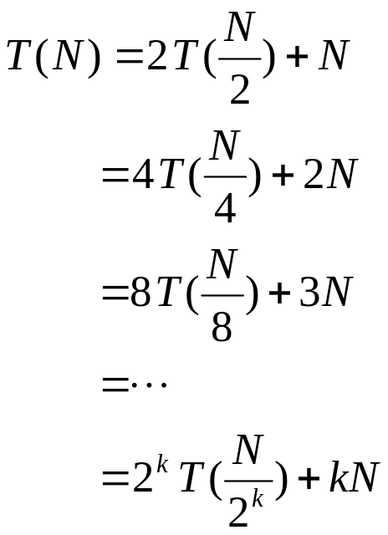
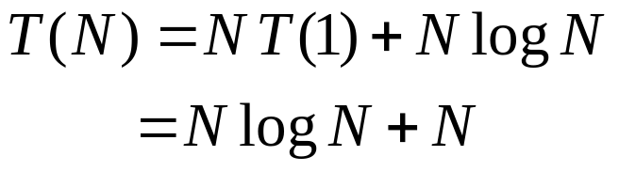
Algorithm 2 (cont’d)
Solving the recurrence:
With k=log N (i.e. 2^{k} = N), we have
Thus, the running time is O(N log N)
  faster than Algorithm 1 for large data sets

Slide 41
Growth-Rate Functions – Example1
i = 1;
sum = 0;
while (i <= n) {
i = i + 1;
sum = sum + i;
}
Cost Times
c1 1
c2 1
c3 n+1
c4 n
c5 n
T(n) = c1 + c2 + (n+1)*c3 + n*c4 + n*c5
= (c3+c4+c5)*n + (c1+c2+c3)
= a*n + b
➔ So, the growth-rate function for this algorithm is O(n)

Slide 42
Growth-Rate Functions – Example2
i=1;
sum = 0;
while (i <= n) {
j=1;
while (j <= n) {
sum = sum + i;
j = j + 1;
}
i = i +1;
}
Cost Times
c1 1
c2 1
c3 n+1
c4 n
c5 n*(n+1)
c6 n*n
c7 n*n
c8 n
T(n) = c1 + c2 + (n+1)*c3 + n*c4 + n*(n+1)*c5+n*n*c6+n*n*c7+n*c8
= (c5+c6+c7)*n² + (c3+c4+c5+c8)*n + (c1+c2+c3)
= a*n² + b*n + c
➔ So, the growth-rate function for this algorithm is O(n²)

Slide 43
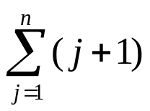
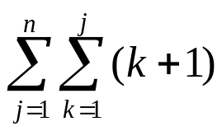
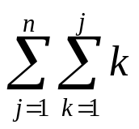
Growth-Rate Functions – Example3
Cost Times
for (i=1; i<=n; i++) c1 n+1
for (j=1; j<=i; j++) c2
for (k=1; k<=j; k++) c3
x=x+1; c4
T(n) = c1*(n+1) + c2*( ) + c3* ( ) + c4*( )
= a*n³ + b*n² + c*n + d
➔ So, the growth-rate function for this algorithm is O(n³)

Slide 44
Growth-Rate Functions – Recursive Algorithms
void hanoi(int n, char source, char dest, char spare) { Cost
if (n > 0) { c1
hanoi(n-1, source, spare, dest); c2
cout << "Move top disk from pole " << source c3
<< " to pole " << dest << endl;
hanoi(n-1, spare, dest, source); c4
} }
The time-complexity function T(n) of a recursive algorithm is defined in terms of itself, and this is known as recurrence equation for T(n).
To find the growth-rate function for a recursive algorithm, we have to solve its recurrence relation.

Slide 45
Growth-Rate Functions – Hanoi Towers
What is the cost of hanoi(n,’A’,’B’,’C’)?
when n=0
T(0) = c1
when n>0
T(n) = c1 + c2 + T(n-1) + c3 + c4 + T(n-1)
= 2*T(n-1) + (c1+c2+c3+c4)
= 2*T(n-1) + c ⬅ recurrence equation for the growth-rate function of hanoi-towers algorithm
Now, we have to solve this recurrence equation to find the growth-rate function of hanoi-towers algorithm

Slide 46
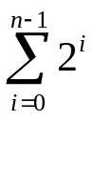
Growth-Rate Functions – Hanoi Towers (cont.)
There are many methods to solve recurrence equations, but we will use a simple method known as repeated substitutions.
T(n) = 2*T(n-1) + c
= 2 * (2*T(n-2)+c) + c
= 2 * (2* (2*T(n-3)+c) + c) + c
= 2³ * T(n-3) + (2²+2¹+2⁰)*c (assuming n>2)
when substitution repeated i-1th times
= 2^{i} * T(n-i) + (2^{i-1}+ ... +2¹+2⁰)*c
when i=n
= 2^{n} * T(0) + (2^{n-1}+ ... +2¹+2⁰)*c
= 2^{n} * c1 + ( )*c
= 2^{n} * c1 + ( 2^{n}-1 )*c = 2^{n}*(c1+c) – c ➔ So, the growth rate function is O(2^{n})

Slide 47
Homework
Please refer to Icourse.
Due date for quiz: 23:30 March 8, 2022
Due date for homework: 23:30 March 13, 2022

